Slide 1

Remaining Useful Life Prediction for Turbofan Engines
A Machine Learning Algorithms for IoT Systems Project
Berke YAMAN (002441990)
Ashish BHIMA (001520258)
Christopher ADU (002085330)

Slide 2
1. Project Overview, Requirements, and Deliverables:
Project Overview:
Predict the Remaining Useful Life (RUL) of turbofan engines to improve maintenance strategies.
Balance early warnings to prevent failures while avoiding unnecessary costs.
Use the CMAPSS dataset to train machine learning models.
Functional Requirements:
Provide RUL predictions based on sensor data during operation.
Allow custom training on specific assets or the entire dataset.
Maintain and specify versions of models for predictions.

Slide 3
2. Project Overview, Requirements, and Deliverables:
Technical Requirements:
Develop and train models using all four datasets.
Build a Flask-based REST API to serve ML models locally.
Create a client application to send sensor data and receive predictions.
Deliverables:
Code for pre-processing, training, and testing the RUL prediction models.
REST API for predictions.
Postman environment for API testing.
Swagger documentation of the API.

Slide 4
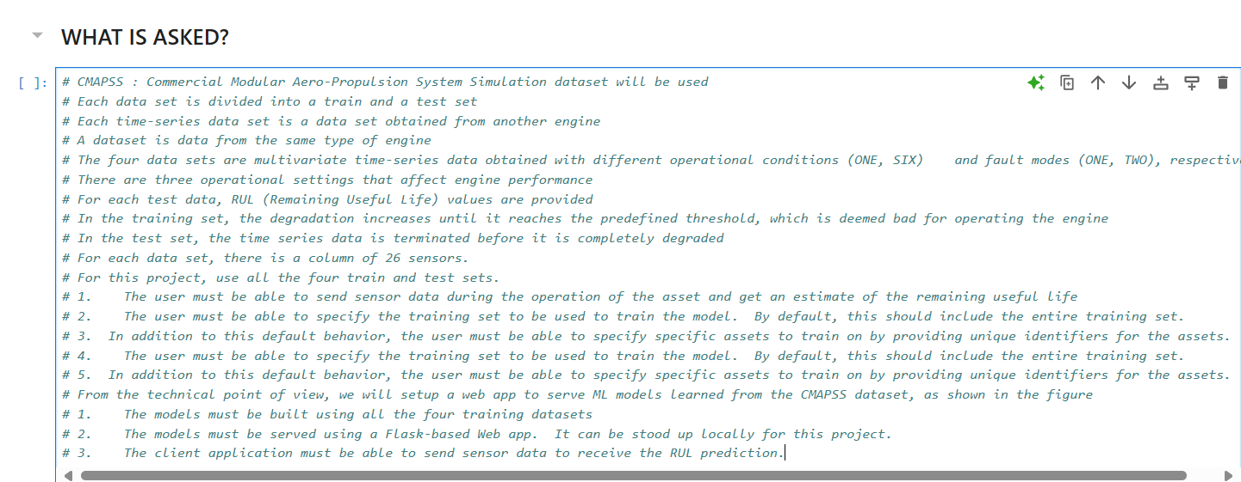
3. Dataset Description:

Slide 5
4. Dataset Description of the CMAPSS Dataset:
The CMAPSS (Commercial Modular Aero-Propulsion System Simulation) dataset is used to train the ML models needed for this system. It is a system developed by NASA to study engine degradation.
CMAPSS Jet Engine Simulated Data | NASA Open Data Portal
It contains multivariate time-series data with 26 sensors.
Includes different operational conditions (ONE, SIX) and fault modes (ONE, TWO).
Four datasets: Training data ends at failure, test data ends earlier.
No missing data

Slide 6
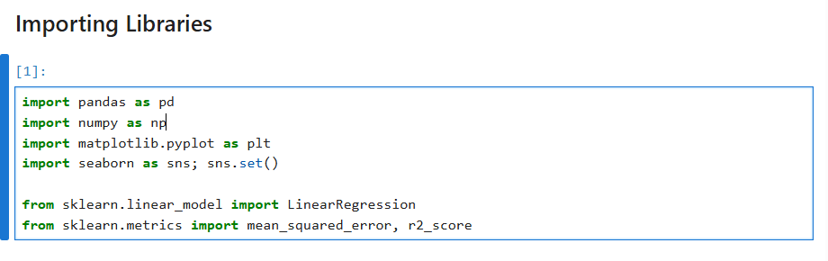
5. Exploratory data analysis of CMAPSS Dataset:

Slide 7
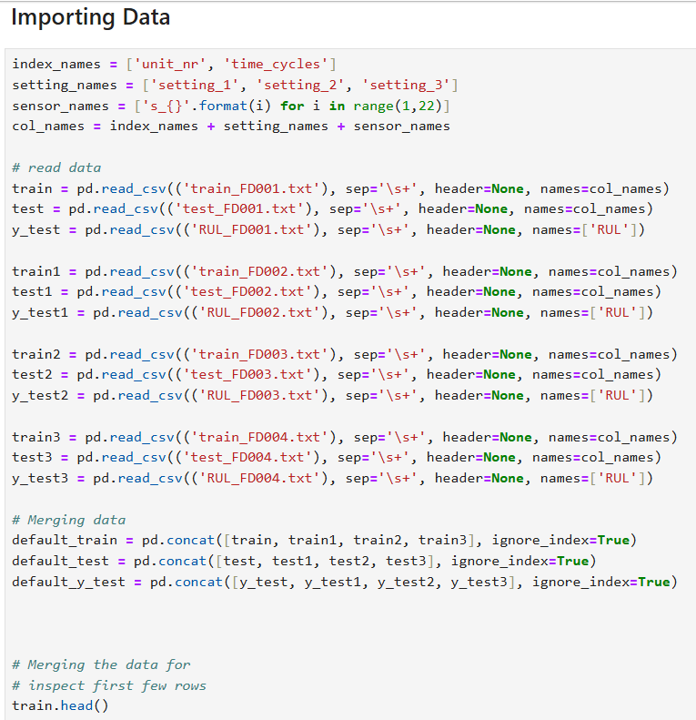
6. Exploratory data analysis of CMAPSS Dataset:
Data Importation and operational parameters setting

Slide 8
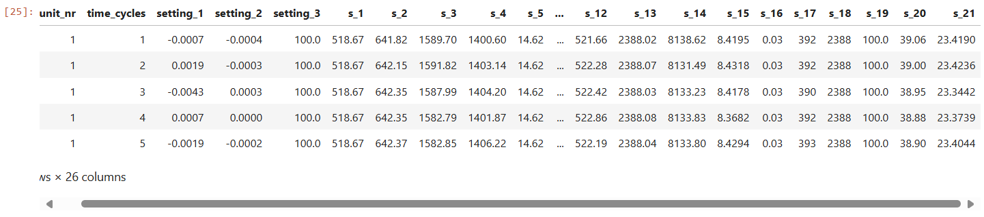
7. Exploratory data analysis of CMAPSS Dataset :
Datasets includes simulations of multiple turbofan engines over time, each row contains the following information:
Engine unit number (unit_nr)
Time, in cycles
Three operational settings (operational settings_3 seems to have no meaningful effect on our output)
21 sensor readings.

Slide 9
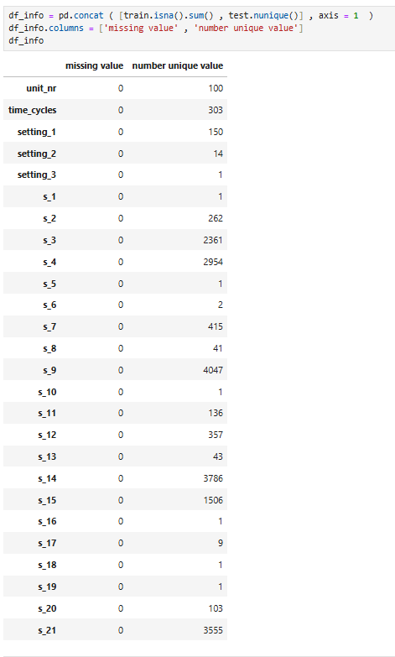
8. Exploratory data analysis of CMAPSS Dataset:
Finding Missing and Unique Columns
Missing values can decrease the effective sample size, leading to:
Lower statistical power.
Reduced accuracy and reliability of estimates.
Missing values can significantly impact the performance and accuracy of machine learning models.
In our case, there are no missing value

Slide 10
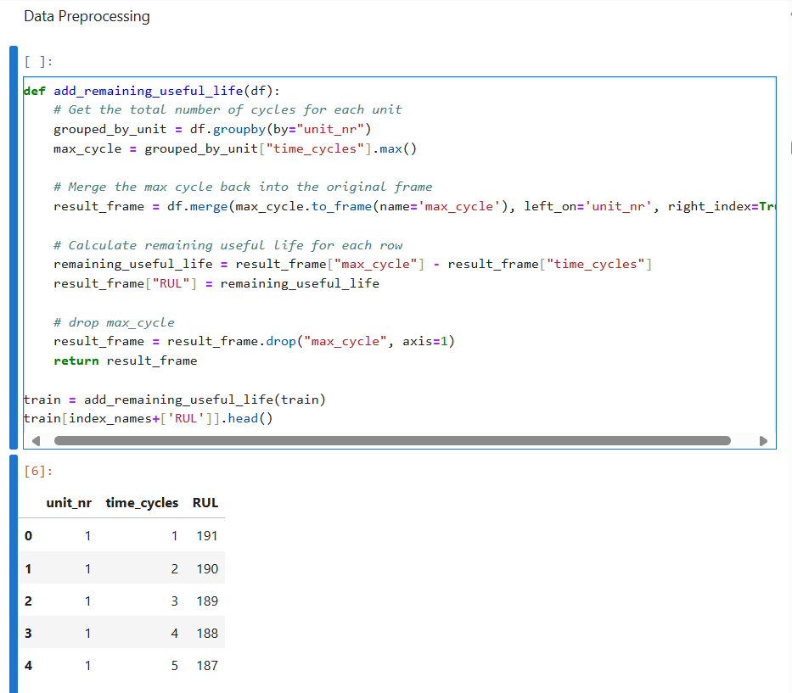
9. Exploratory data analysis of CMAPSS Dataset:
Data preprocessing enhances the quality of input data by:
Handling missing values through techniques like imputation.
Removing or dropping outliers.
Addressing inconsistencies and errors in the dataset

Slide 11
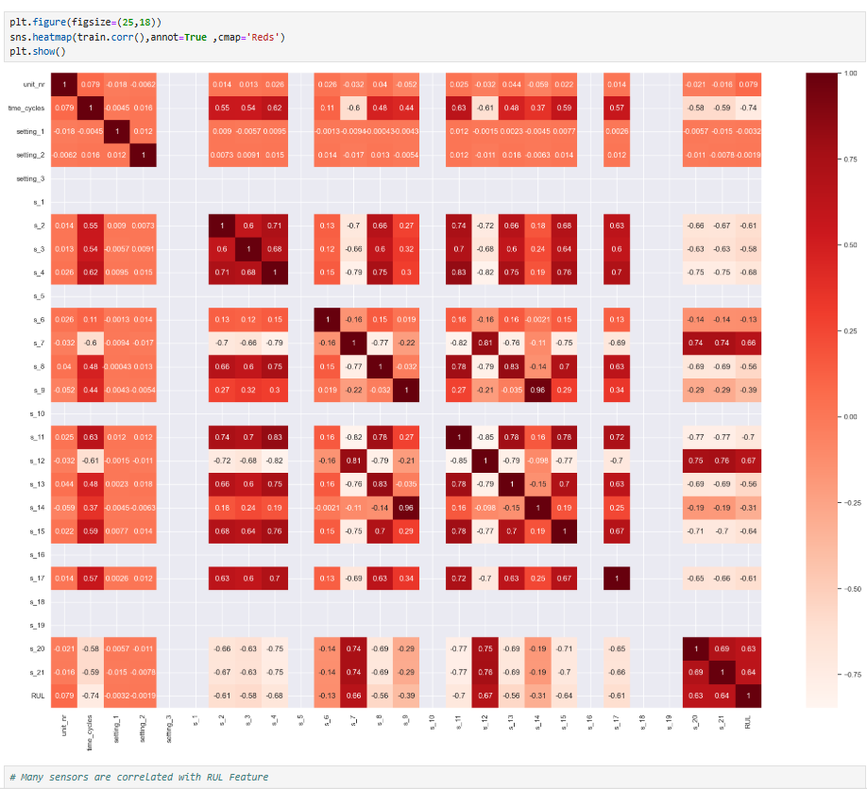
10. Exploratory data analysis of CMAPSS Dataset:
Correlation Analysis
This is done to select only important features for model building to avoid problem of " Overfitting".
All the sensors have high correlation with room occupancy.

Slide 12
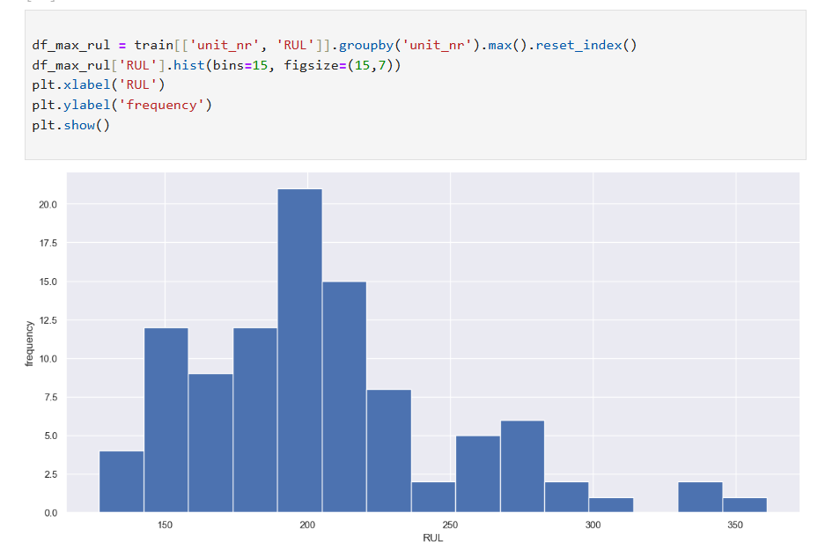
11. Data Preprocessing data analysis of CMAPSS Dataset:
The histogram represents the frequency distribution of maximum RUL values for different engine units.
It shows that:
The distribution range from about 150 to 350 cycles.
Also, most engines have RUL values clustered around 200 cycles which indicates the most common failure point for these engines..
In terms of predictive Maintenance, this RUL distribution will be crucial for:
Planning maintenance schedules.
Allocating resources efficiently.
Preventing unexpected failures.

Slide 13
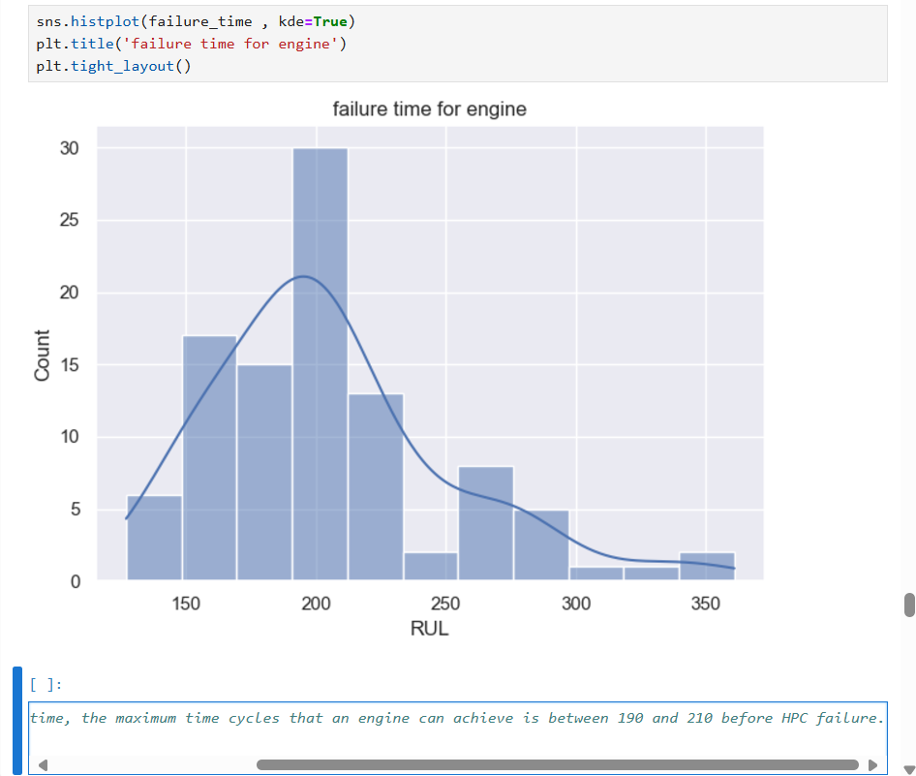
12. Data Preprocessing data analysis of CMAPSS Dataset:
Although, most engines have RUL values clustered around 200 cycles, we notice that:
In most of the time, the maximum time cycles that an engine can achieve is between 190 and 210 before HPC failure.

Slide 14
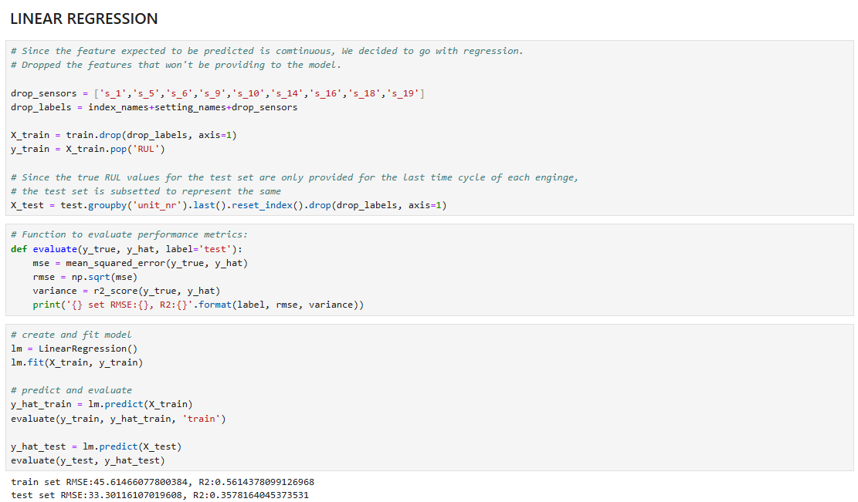
13. Model Training:
A simple linear regression model was trained and tested on the dataset :
A very high RMSE value was recorded for both the train set (45.61) and test set (33.30).

Slide 15
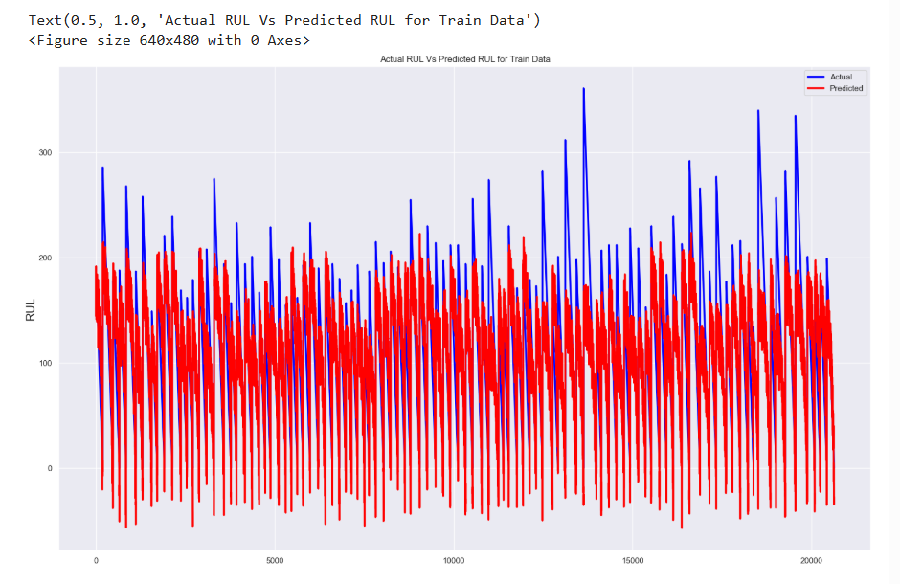
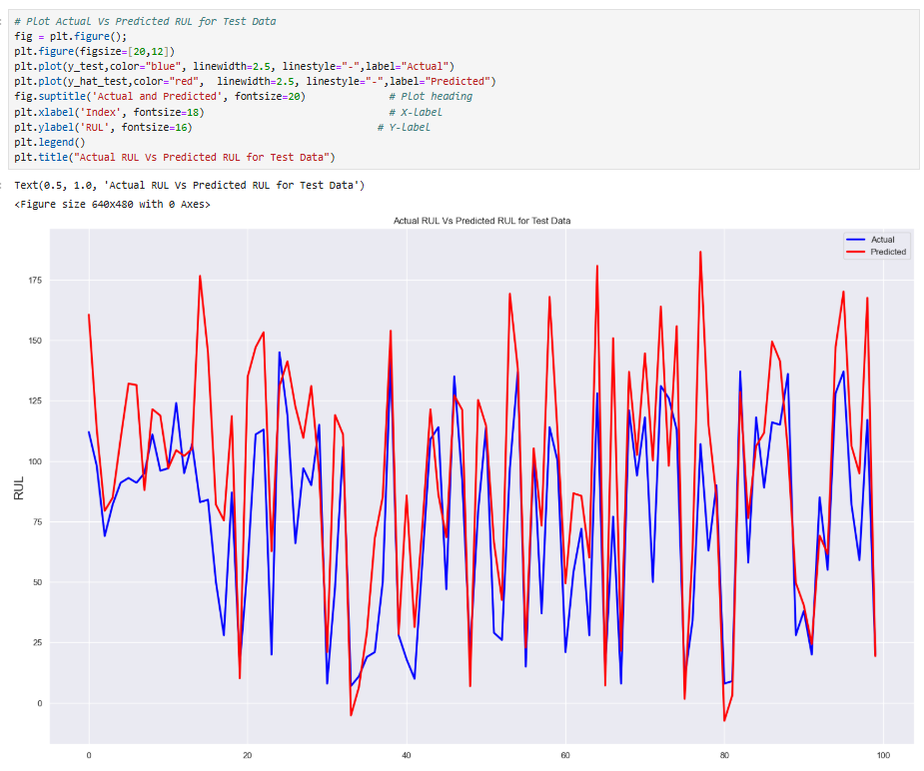
14. Data Preprocessing data analysis of CMAPSS Dataset:
Plot of Train and Test set

Slide 16
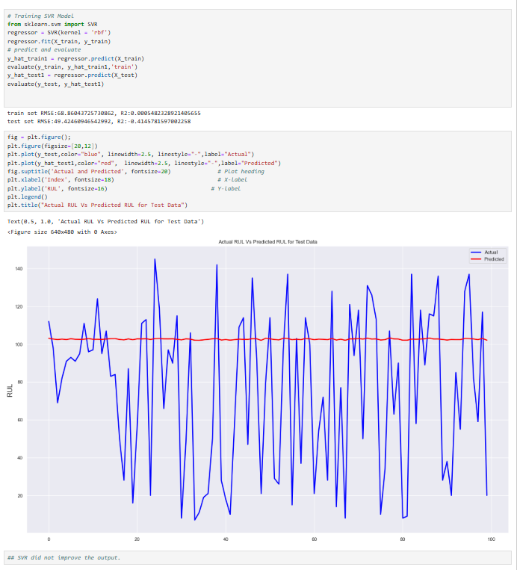
16. Model Train and Testing:
SVM Model
The SVM did not improve our output. It essentially performed poorly and recorded even higher RMSE values.

Slide 17
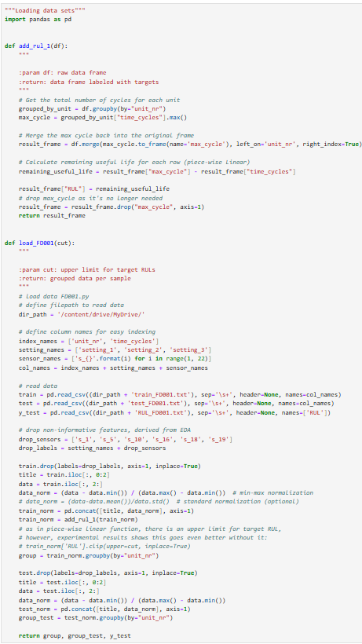
18. Model Test and Training:
LTSM Model
This model's sophisticated architecture and memory management capabilities make it particularly suitable for complex sequential tasks requiring long-term memory and pattern recognition

Slide 18
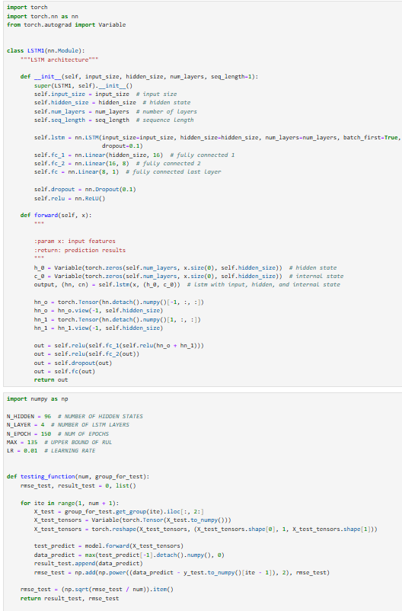
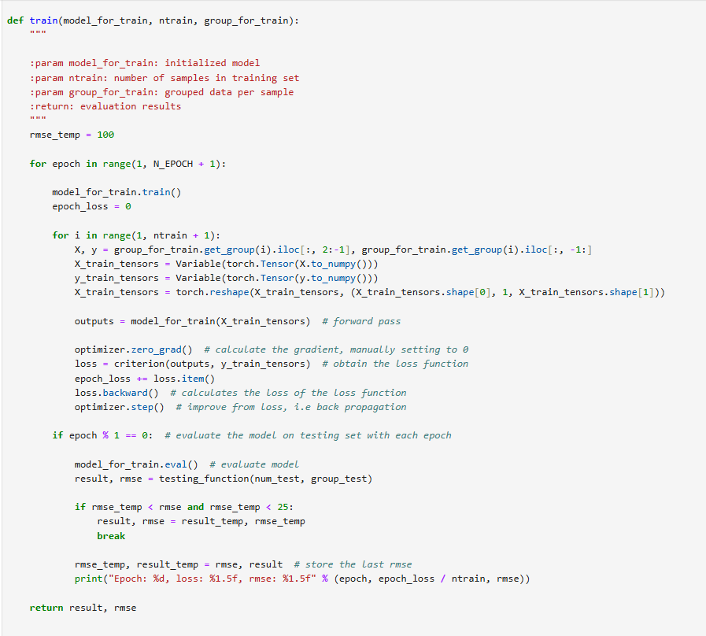
19. Model Training and Testing on Dataset:
LTSM Model

Slide 19
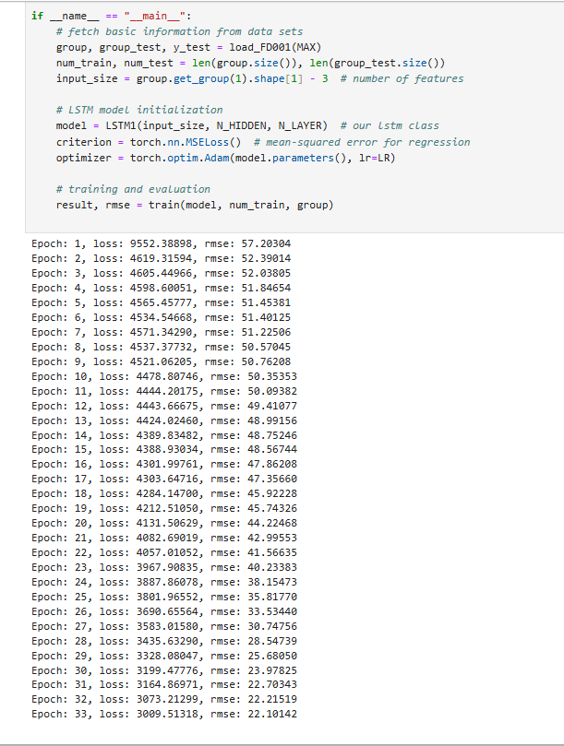
20. Data Preprocessing data analysis of CMAPSS Dataset:
LTSM Model
The model shows consistent improvement in both loss and RMSE metrics over 33 epochs
Initial performance starts at:
Loss: 9552.38898
RMSE: 57.20304
Final performance reaches:
Loss: 3009.51318
RMSE: 22.19142

Slide 20
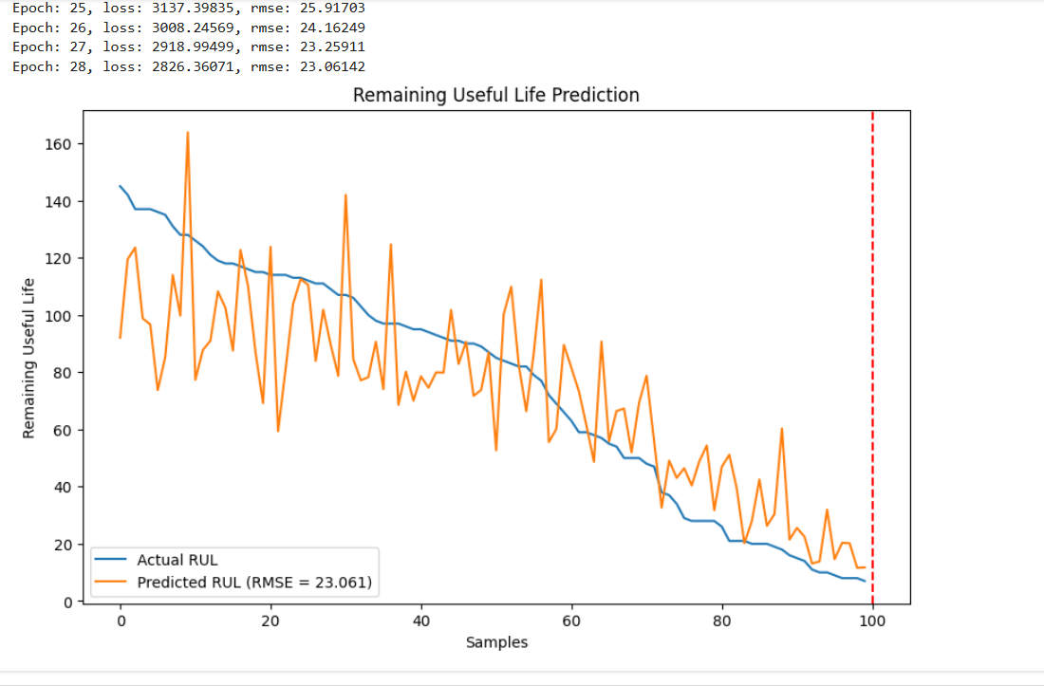
20. Data Preprocessing data analysis of CMAPSS Dataset:
LTSM Model
The model shows consistent improvement in both loss and RMSE metrics over 28 epochs
Initial performance starts at:
Loss: 2826.36071
RMSE: 23.06142

Slide 21
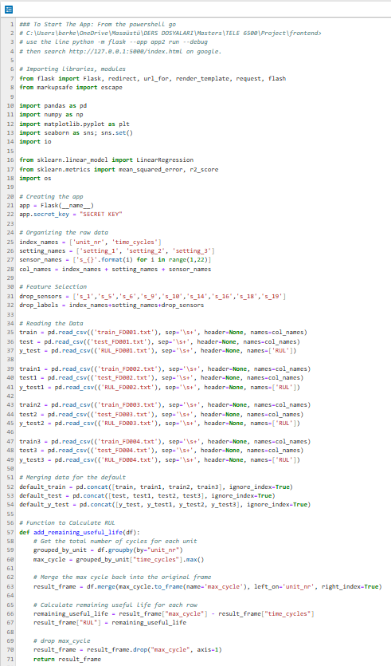
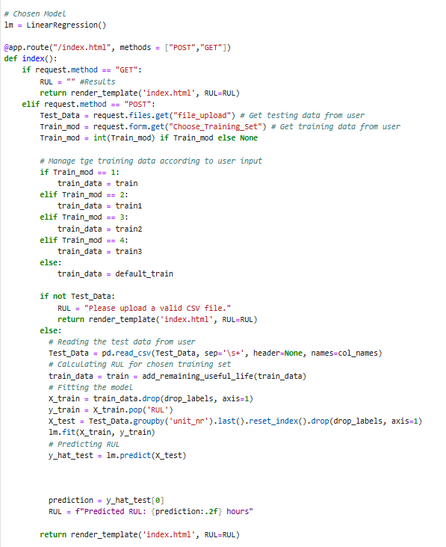
21. Flask-based REST API :

Slide 22
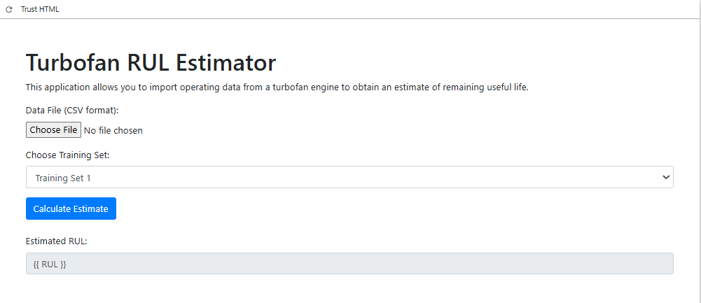
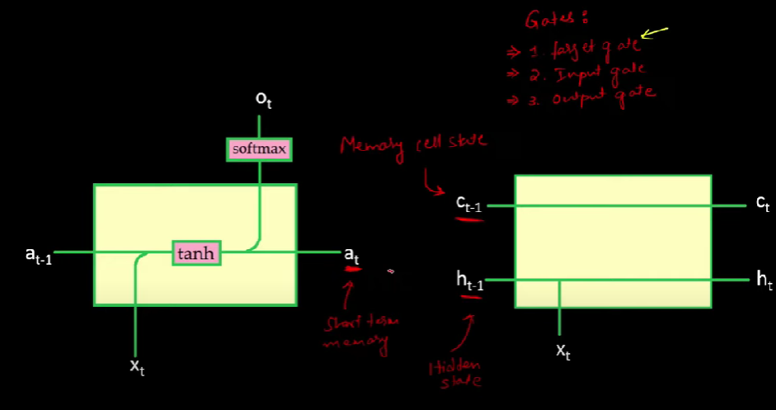
22. Flask-based REST API :
This framework's simplicity and flexibility make it particularly suitable for building small to medium-sized web services and APIs.

